Slide 1
COMPUTER PROGRAMMING IN C
UNIT - 1
SESSION - 6

Slide 2
INTRODUCTION TO C LANGUAGE
BACKGROUND INPUT/OUTPUT
C PROGRAMS OPERATORS
IDENTIFIERS EXPRESSIONS
TYPES PRECEDENCE & ASSOCIATIVITY
VARIABLES EXPRESSION EVALUATION
CONSTANTS TYPE CONVERSION

Slide 3
Objectives of Today's Session
To be able to create and use constants.
To understand input and output concepts.
To be able to use simple input and output statements.

Slide 4
CONSTANTS
CONSTANT REPRESENTATION
CODING CONSTANTS

Slide 5
CONSTANTS
C Constants is a most basic and important part of C programming language. Constants in C are the fixed values that are used in a program, and its value remains the same during the entire execution of the program.
Constants are also called literals.
Constants can be any of the data type.
It is considered best practice to define constants using only upper-case names.
Syntax:
const type constant_name;
Here, const keyword defines a constant in C.

Slide 6
Example program on Constants
#include<stdio.h> main() { const int SIDE = 10; int area; area = SIDE*SIDE; printf("The area of the square with side: %d is: %d sq. units", SIDE, area); }
Output:
The area of the square with side: 10 is: 100 sq. units
NOTE :
It is possible to put const either before or after the type.
int const SIDE = 10; ( or ) const int SIDE = 10;

Slide 7
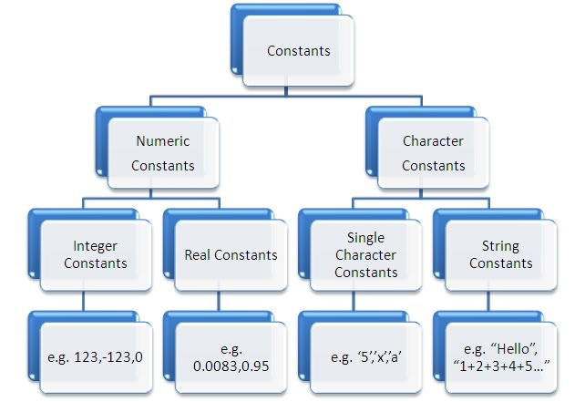

Slide 8
Constant Types in C
Constants is categorized into two basic types and each of these types has own subtypes/categories.
These are:
Numeric Constants - It consists of sequence of digits.
Integer Constants
Real Constants
Character Constants - Character constants have specific set of integer values known as ASCII values (American Standard Code for Information Interchange).
Single Character Constants
String Constants
Backslash Character Constants

Slide 9
Integer Constant
It’s refer to sequence of digits. Integers are of three types viz:
Decimal Integer - consists of a set of digits 0 to 9 preceded by an optional + or - sign. Spaces, commas and non digit characters are not permitted between digits. Example for valid decimal integer constants are int y=123; //here 123 is a decimal integer constant
Octal Integer - constant consists of any combination of digits from 0 through 7 with a O at the beginning. Some examples of octal integers are int X=O123; // here 0123 is a octal integer constant .
Hexadecimal Integer - constant is preceded by OX or Ox, they may contain alphabets from A to F or a to f. The alphabets A to F refers to 10 to 15 in decimal digits. Example of valid hexadecimal integers are int x=Ox12 // here Ox12 is a Hexadecimal integer constant

Slide 10
Real constant
The numbers containing fractional parts like 99.25 are called real or floating points constant.
Real Numbers can also be represented by exponential notation.
The exponent is an integer number with an optional plus or minus sign.
These are used for some quantities which varies continuous such as height, distance, temperature etc.,
Example : valid - 3.59, -8.52 etc.,
Invalid - 853, 5,213 etc.,

Slide 11
Single Character Constants
A Single Character constant represent a single character which is enclosed in a pair of single quotation symbols.
Example: ‘X’, ‘5’, ‘;’
These are internally stored as integers, which are having ASCII values
Example : printf ( “ %d “, ‘a’ );
output : 97

Slide 12
String Constants
These are set of characters enclosed in double quotes and they may include letters, digits, special characters and blank-spaces.
It is again to be noted that “G” and ‘G‘ are different – because “G” represents string as it is enclosed within pair of double quotes whereas ‘G’ represents a single character.
Example: “Hello!”, “2015”, “2+1”

Slide 13
Backslash character constant
C supports some character constants having backslash in front of it.
The lists of backslash characters have specific meaning which is known to the compiler.
They are also termed as “Escape Sequence”.
For Example:
\t is used to give a tab
\n is used to give new line

Slide 14
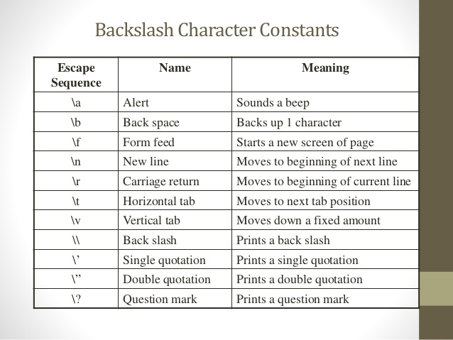

Slide 15
INPUT/OUTPUT
In order to keep C Programming language compact, Dennis Ritchie removed anything related to the input or output from the definition of the language.
Therefore, C has no provisions for input and output of data from input and output devices.
In order to solve this little discrepancy, the C developers developed several standard input and output functions and placed them in C libraries.
All these libraries are accessible by all the C compilers.

Slide 16
TYPES OF INPUT/OUTPUT FUNCTIONS
A lot of Input/output functions have been defined in the standard libraries.
These can be classified as follows:
Console I/O functions: These functions allow us to receive input from the input devices like keyboard and provide output to the output devices like the Visual Display Unit (VDU).
File I/O functions: These functions allow us to access the hard disk or floppy disk to perform input and output.

Slide 17
CONSOLE I/O FUNCTIONS
A console comprises the VDS (virtual dedicated server) and the keyboard.
The Console Input and Output functions can be classified into two categories:
Formatted console I/O functions: These functions allow the user to format the input from the keyboard and the output displayed in the desired manner.
Unformatted console I/O functions: These functions do not allow the user this feature.

Slide 18
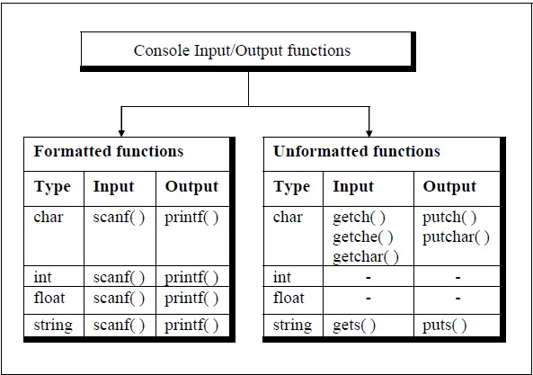

Slide 19
FORMATTED CONSOLE INPUT FUNCTION: SCANF()
scanf() is the formatted console input function which reads formatted input from stdin(standard input).
It can read any integer, float, character, string etc., data from the user.
The syntax of using scanf() is as follows:
scanf("format specifier" ,arguments address or & arguments);
Let us consider an example: scanf(“%d”, &num);
In this example, the %d is the format specifier for an integer hence, num stores an integer value.
&num indicates the address of num where the value is to be stored under the variable name ‘num’.
Note:- 1. One disadvantage of scanf() when taking string inputs is that it will ignore the string that has been entered after a blank space.Thus, scanf() does not take multi-word string inputs.
2. To take multi word string inputs we should use gets() method.

Slide 20
FORMATTED CONSOLE OUTPUT FUNCTION: PRINTF()
printf() is the formatted console output function which prints the formatted output to the stdout(standard output).
It can display integers, floating point values, characters, string etc., as indicated by the user.
The syntax of using printf() is as follows: printf("text");
This shall simply print “text” on the output screen.
Any other textual data can be written within double quotes and displayed using printf() function.
In order to print any variable value along with text we have the following format: printf("text <format specifier>",variable); or printf("format specifier" ,arguments );
For example, printf(“marks: %d”,marks);
This has the format specifier as %d which stands for integer data and it shall print the marks in integer format.

Slide 21
Example of scanf() and printf() functions
#include<stdio.h>
int main( )
{ int i;
printf( “Enter a value” );
scanf( “%d”, &i );
printf( “ \nYou entered : %d”, i );
return 0;
}
Note: 1. For floating point values the format specifier is %f and it shall print 6 decimal places after the floating point. For example, 3.6 will be displayed as 3.600000.
2. In order to limit the decimal places after the floating point, the format specifier can be written as %0.3f for 3 decimal places after the floating point.

Slide 22
UNFORMATTED CONSOLE I/O FUNCTIONS
The unformatted console input/output functions deal with a single character or a string of characters. Let us see how all these unformatted functions work:
Functions Description
getch( ) - This function returns the character that was typed last or was typed most recently. It does not
display(echo) the character on the screen. It is present in the headerf ile <conio.h>.
getche( ) - This function is the same as getch(). The only difference is that it echoes(displays) the most
recently used character. It is also present in <conio.h>.
getchar( ) - getchar() is a macro that works in a similar manner as getch() and also displays(echoes) the
character but it needs the user to press the Enter key after the character. It is present in the
header file <stdio.h>.
fgetchar( ) - fgetchar() works in the same manner as getchar() . But fgetchar() is a function.It is also
present in <stdio.h>.
putch( ) - This function prints a single character on the console.
putchar( ) - This function works in the same way as putch().
fputchar( ) - This function works in the same way as putch().
gets( ) - It takes a string input(single-word or multi-word) from the user. It terminates when the Enter key
is pressed.
puts( ) - It is used to print the string to the console.

Slide 23
getchar( ) & putchar( ) functions
The getchar( ) function reads a character from the terminal and returns it as an integer. This function reads only single character at a time. You can use this method in the loop in case you want to read more than one characters.
The putchar( ) function prints the character passed to it on the screen and returns the same character. This function puts only single character at a time. In case you want to display more than one characters, use putchar( ) method in the loop.
Example :
#include<stdio.h>
int main( )
{ int c;
printf( “Enter a character” );
c = getchar( );
putchar( c );
return 0;
}

Slide 24
gets() & puts() functions
The gets( ) function reads a line from stdin into the buffer pointed to by s until either a terminating newline or EOF (end of file) occurs.
The puts( ) function writes the string s and a trailing newline to stdout.
Example :
#include<stdio.h>
int main( )
{ char str[100];
printf( “Enter a string” );
gets( str );
puts ( str );
return 0;
}

Slide 25
Difference between scanf( ) and gets( )
The main difference between these two functions is that scanf( ) stops reading characters when it encounters a space, but gets( ) reads space as character too.
Example :
If you enter name as Study Tonight using scanf( ) it will only read and store Study and will leave the part after space.
But gets( ) function will read it completely.

